Slide 1
NORTH OGDEN POLICE DEPARTMENT AND JUSTICE COURT
VIRTUAL TOUR

Slide 2
WELCOME TO OUR TOUR
THE FOLLOWING SLIDES CONTAIN PHOTOGRAPHS OF THE CURRENT NORTH OGDEN POLICE DEPARTMENT AND JUSTICE COURT FACILITY AS WELL AS PHOTOGRAPHS OF A MODERN FACILITY, TOOELE PD, IN A SIDE BY SIDE COMPARISON.
FACILITY SIZES
NORTH OGDEN 7,250 SQ FT
TOOELE 25,000 SQ FT

Slide 3
THE NORTH OGDEN FACILITY
THE BUILDING WE CURRENTLY OCCUPY WAS BUILT IN 1962. THE BUILDING WAS NEVER DESIGNED TO FUNCTION AS A POLICE DEPARTMENT. THERE IS INADEQUATE SPACE AND STORAGE FOR OUR CURRENT AND FUTURE OPPERATIONS. THE SAFETY AND SECURITY OF STAFF, CITIZENS, AND PARTICIPANTS OF THE CRIMINAL JUSTICE SYSTEM ARE MAJOR CONCERNS.

Slide 4
TOOELE PD
TOOELE CITY’S NEW POLICE DEPARTMENT WAS COMPLETED IN MARCH 2020. THE BUILDING THEY OCCUPIED PRIOR WAS ABOUT THE SAME AGE AS THE CURRENT NORTH OGDEN POLICE DEPARTMENT BUILDING. THE 5.7 MAGNITUDE EARTHQUAKE ON MARCH 18TH DAMAGED TOOELE’S OLD BUILDING TO THE POINT THAT IT WAS CONDEMNED AND HAD TO BE IMMEDIATELY VACATED. FORTUNATELY THEIR NEW BUILDING WAS A FEW WEEKS AWAY FROM BEING FINISHED.

Slide 5
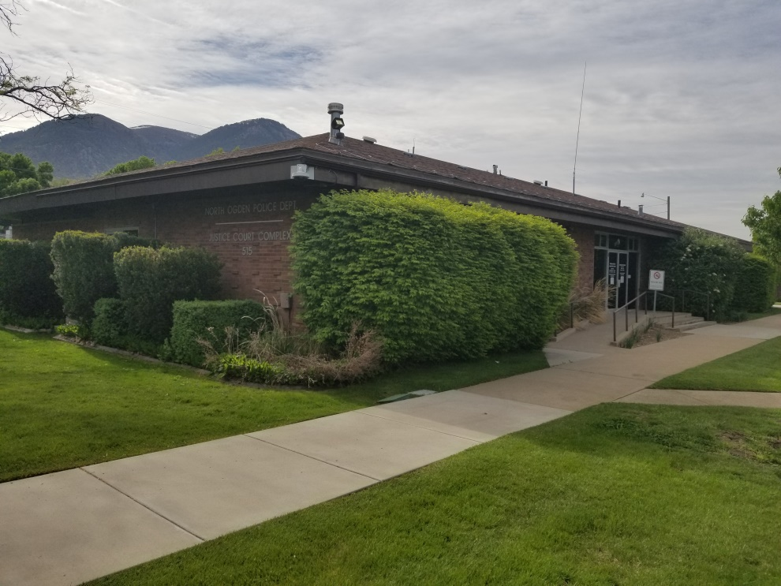
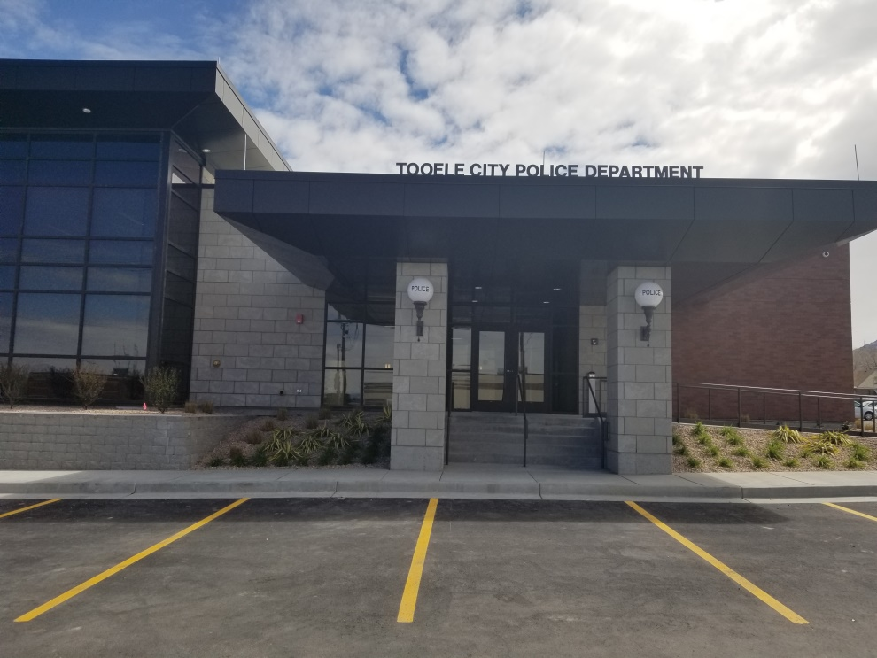
OUTSIDE AND PUBLIC ENTRANCE
NORTH OGDEN PD
TOOELE PD

Slide 6
FRONT LOBBY – OPEN TO THE PUBLIC
THE NOPD LOBBY IS SHARED BETWEEN THE COURT AND THE POLICE. THE PROXIMITY OF THE COURT AND POLICE RECEPTION AREAS ARE A PROBLEM DUE TO PUBLIC PERCEPTION OF BIAS AND COLLABORATION BETWEEN THE TWO ENTITIES. THE SMALL LOBBY AREA CAN BE EXTREMELY CONGESTED ON COURT DAYS. CITIZENS AND STAFF FIND IT DIFFICULT TO CONDUCT BUSINESS AT THE WINDOWS DUE TO THE CONGESTION AND NOISE.

Slide 7
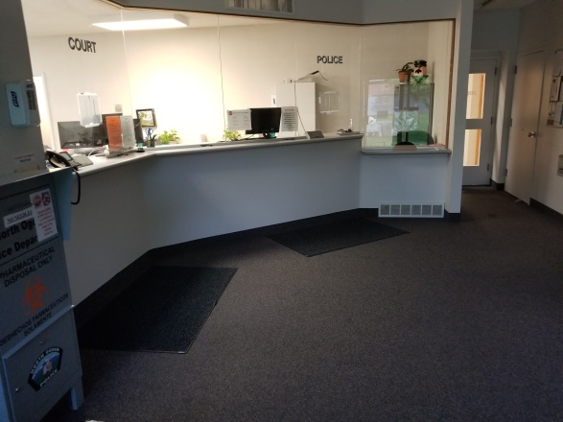
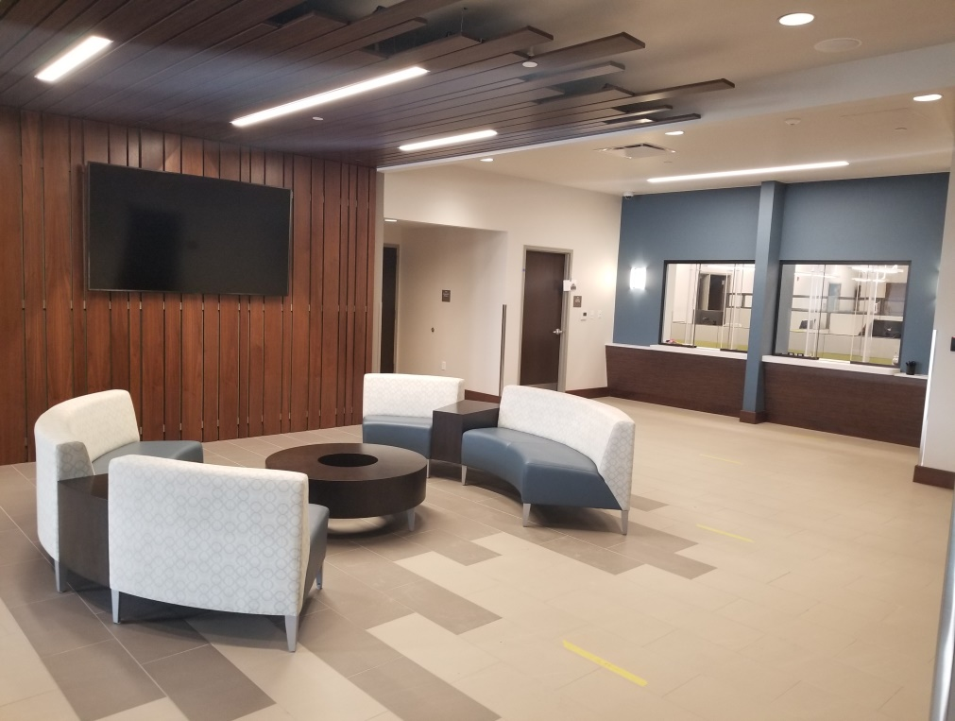
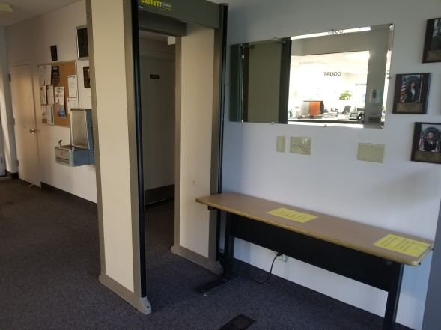
FRONT LOBBY – OPEN TO THE PUBLIC
NORTH OGDEN PD
TOOELE PD

Slide 8
RECORDS DEPARTMENT AND SUPPORT STAFF
THE NEXT SLIDE SHOWS THE RECEPTION AND RECORDS DEPARTMENT AREA. THE NORTH OGDEN PHOTO AGAIN SHOWS POLICE AND COURT OCCUPYING THE SAME SPACE. PREFERABLY THESE ENTITIES ARE SEPARATED. NOT SHOWN IN THE TOOELE PHOTO IS THE ADDITIONAL OFFICES AND STORAGE TO THE SIDE FOR ADDITIONAL SUPPORT STAFF SUCH AS ANIMAL CONTROL, CODE ENFORCEMENT, AND RECORDS STORAGE. THE STAFF OCCUPYING THIS AREA IN TOOELE HAVE THE ADDED SECURITY OF BALLISTIC WALLS AND WINDOWS SEPARATING THEM FROM ANY THREATS.

Slide 9
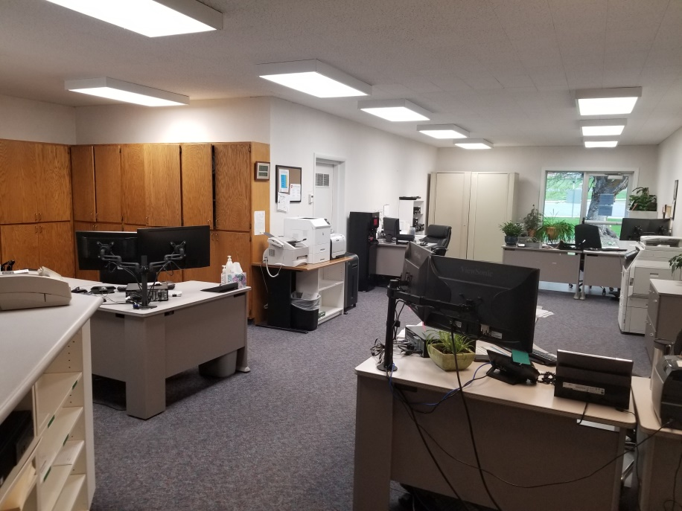
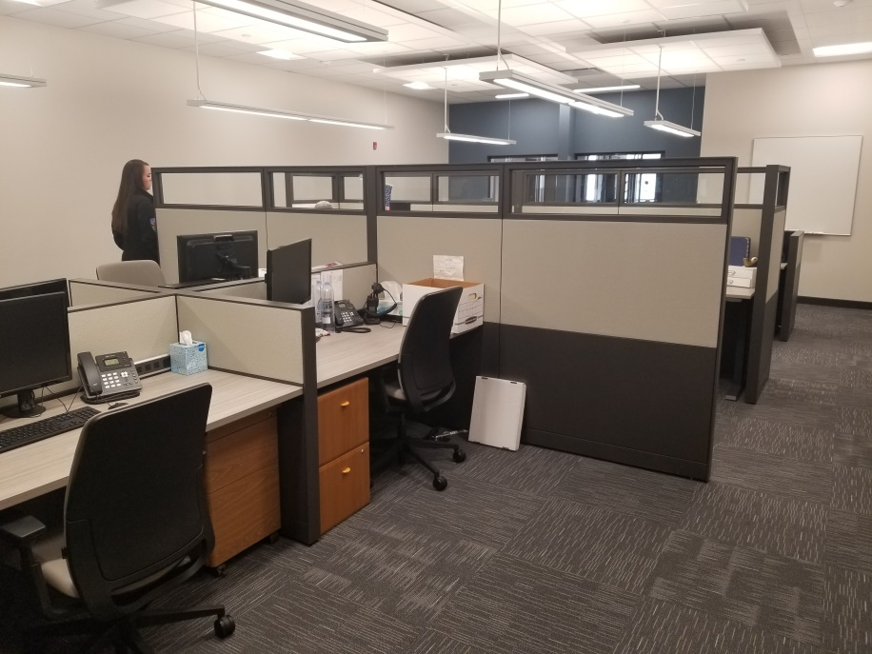
RECORDS DEPARTMENT AND SUPPORT STAFF
NORTH OGDEN PD
TOOELE PD

Slide 10
VICTIM ADVOCATE
THE VICTIM ADVOCATE PLAYS AN IMPORTANT ROLE IN LAW ENFORCEMENT. IN MOST INCIDENTS, VICTIMS OF CRIME DO NOT KNOW HOW TO NAVIGATE THEIR WAY THROUGH COURT SYSTEMS, COURT PROCEEDINGS, AND THE MANY RESOURCES THAT ARE AVAILABLE TO THEM. VICTIMS OF CRIME MAY HAVE RECENTLY BEEN EXPOSED TO A TRAUMATIC EVENT. THE VICTIM ADVOCATE NEEDS A SPACE THAT IS WARM AND WELCOMING WHERE THEY CAN MEET WITH VICTIMS. THIS SPACE NEEDS TO ACCOMMODATE VICTIMS OF ALL AGES AND OF ALL GENDERS.

Slide 11
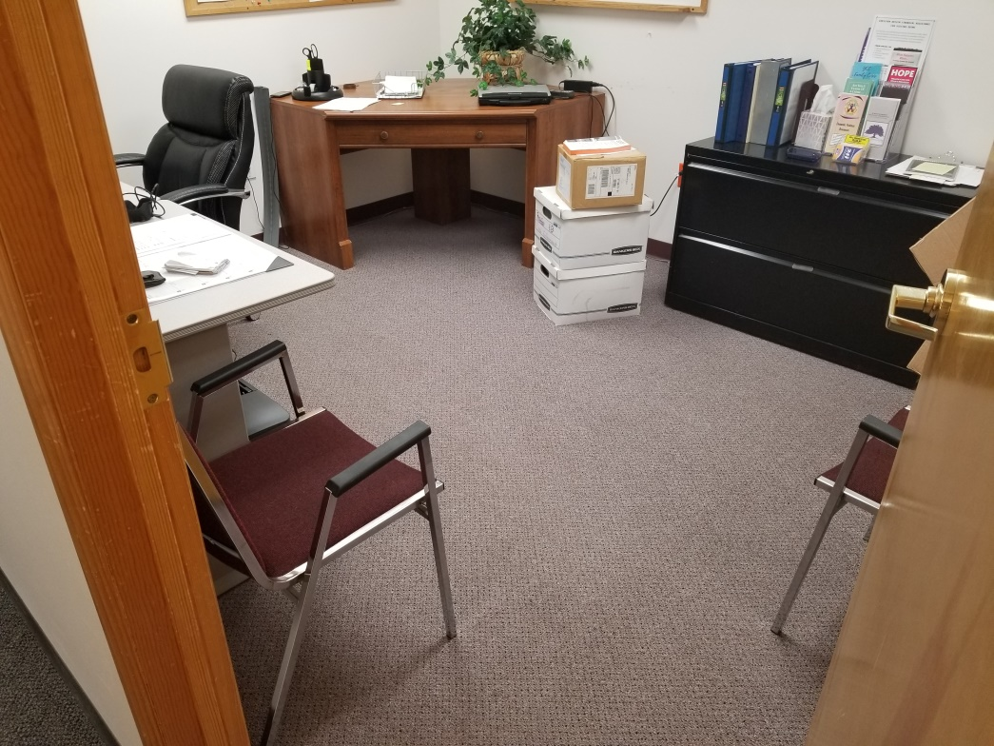
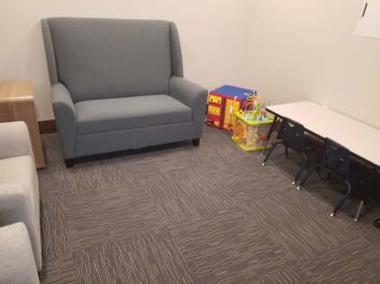
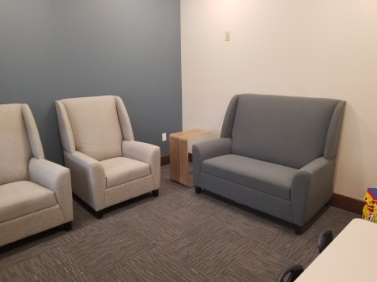
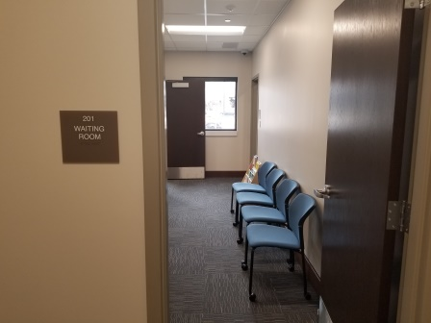
VICTIM ADVOCATE
NORTH OGDEN PD
TOOELE PD

Slide 12
CONFERENCE/BRIEFING/TRAINING ROOMS
CONFERENCE, BRIEFING, AND TRAINING ROOMS ARE VERY IMPORTANT IN PUBLIC SAFETY. CONFERENCE ROOMS NEED TO ACCOMMODATE THE AGENCY’S ADMINISTRATIVE AND SUPERVISORY STAFF WHEN MEETING AND ADDRESSING ADMINISTRATIVE BUSINESS. BRIEFING AREAS ARE ESSENTIAL WHEN DISCUSSING CRITICAL OPPERATIONAL STRATEGIES. THIS CAN BE THE PATROL STAFF MEETING BEFORE A SHIFT, SWAT TEAMS AND NARCOTIC STRIKE FORCE TEAMS MEETING BEFORE A MAJOR TACTICAL MISSION, OR ANYTHING INBETWEEN. THE TRAINING ROOM NEEDS TO BE LARGE ENOUGH TO ACCOMMODATE UP TO 3O PEOPLE FOR IN HOUSE TRAININGS AND CERTIFICATIONS. IT IS ALSO AN IMPORTANT AREA FOR MULTI JURISDICTIONAL MEETINGS AND TRAININGS WHICH NOPD IS OFTEN TASKED WITH HOSTING.

Slide 13
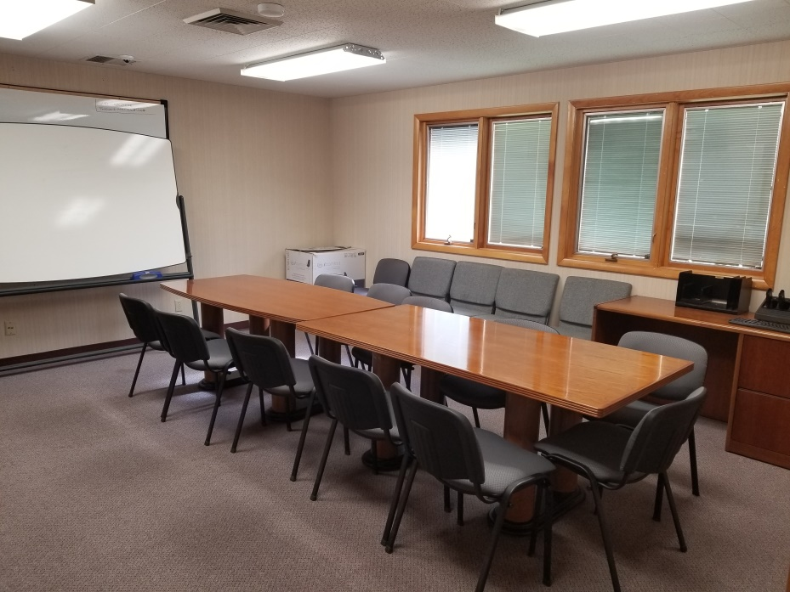
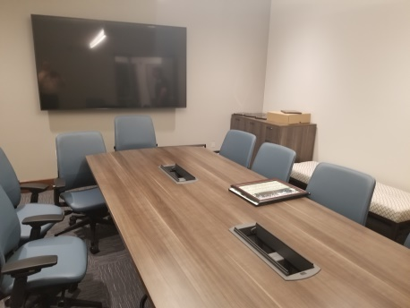
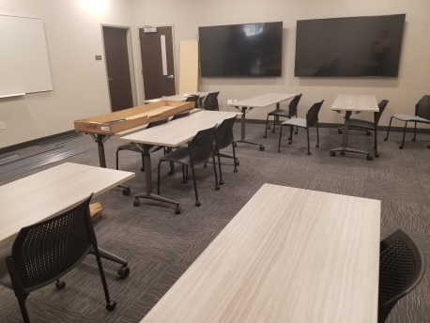
CONFERENCE/BRIEFING/TRAINING ROOM
NORTH OGDEN PD
TOOELE PD

Slide 14
INVESTIGATIONS
AN UP-TO-DATE, MODERN INVESTIGATIONS AREA WOULD PROVIDE INDIVIDUAL SPACE BUT AT THE SAME TIME ALLOW FOR COLLABORATION BETWEEN INVESTIGATORS AND SUPERVISORS.

Slide 15
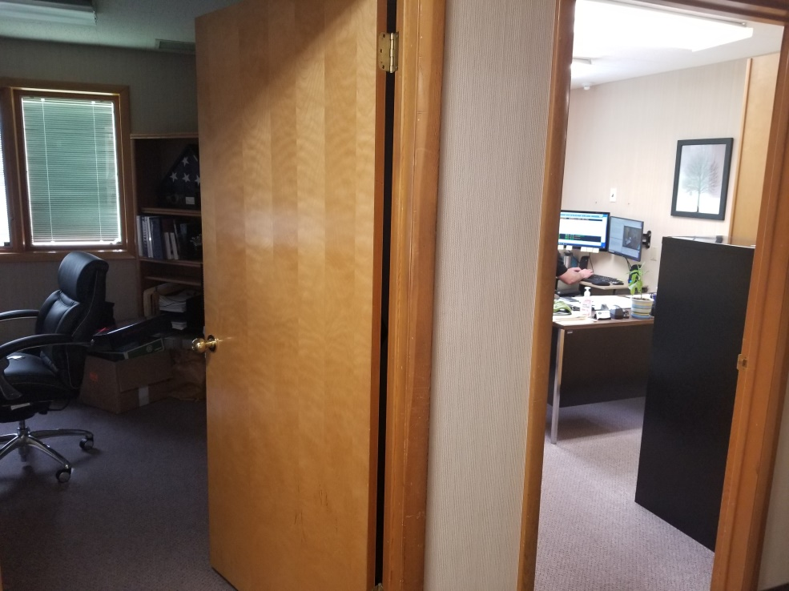
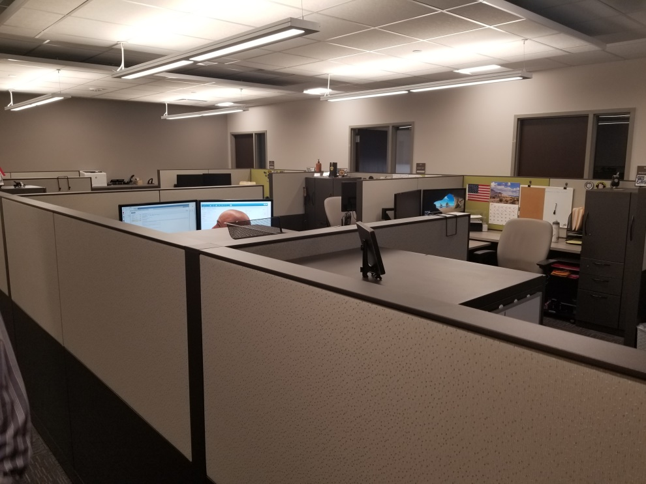
INVESTIGATIONS
NORTH OGDEN PD
(2 OFFICES)
TOOELE PD
(MULTIPLE WORK STATIONS)

Slide 16
PATROL DIVISION
THE PATROL STAFF NEEDS THE APPROPRIATE AMOUNT OF SPACE FOR PROCESSING REPORTS AND PAPERWORK. A SMALL AMOUNT OF INDIVIDUAL SPACE IS ALSO IMPORTANT FOR PERSONNAL FILES AND STORAGE. OUR PATROL STAFF IS GROWING AND HAS ALREADY OUTGROWN OUR CURRENT PATROL AREAS. AS YOU CAN SEE FROM THE NOPD PHOTO, STORAGE IS A HUGE PROBLEM.

Slide 17
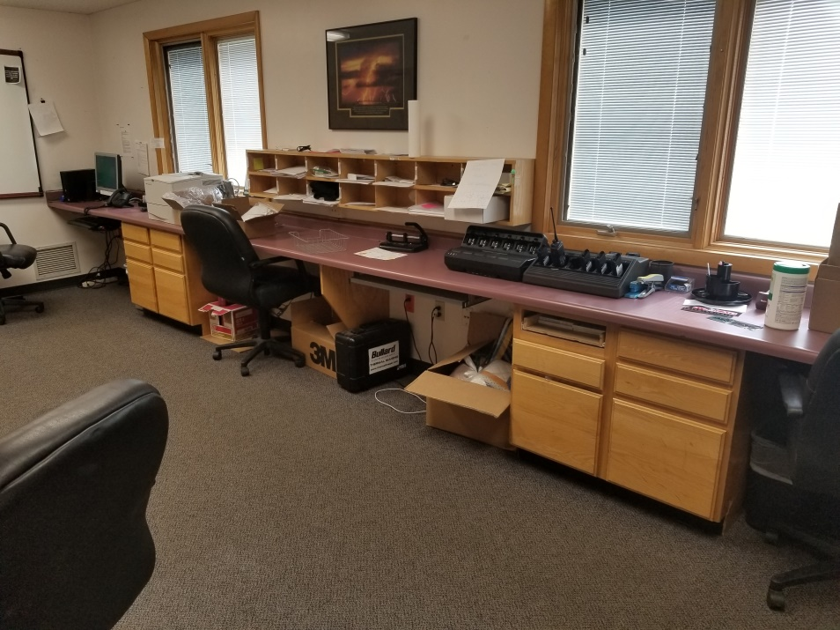
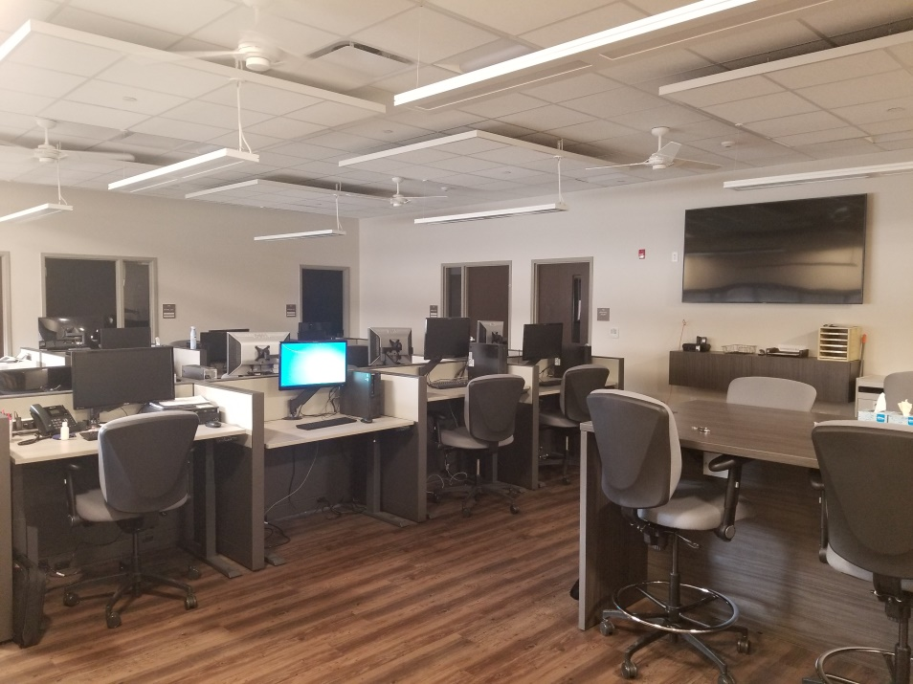
PATROL DIVISION
NORTH OGDEN PD
TOOELE PD

Slide 18
SUPERVISOR OFFICES
THE SUPERVISORS ARE CRAMMED INTO THEIR SPACE. AS WITH ALL OF THE OFFICES AND SPACES IN THE CURRENT FACILITY, OUTDATED FURNITURE AND A LACK OF STORAGE ARE MAJOR CONCERNS.

Slide 19
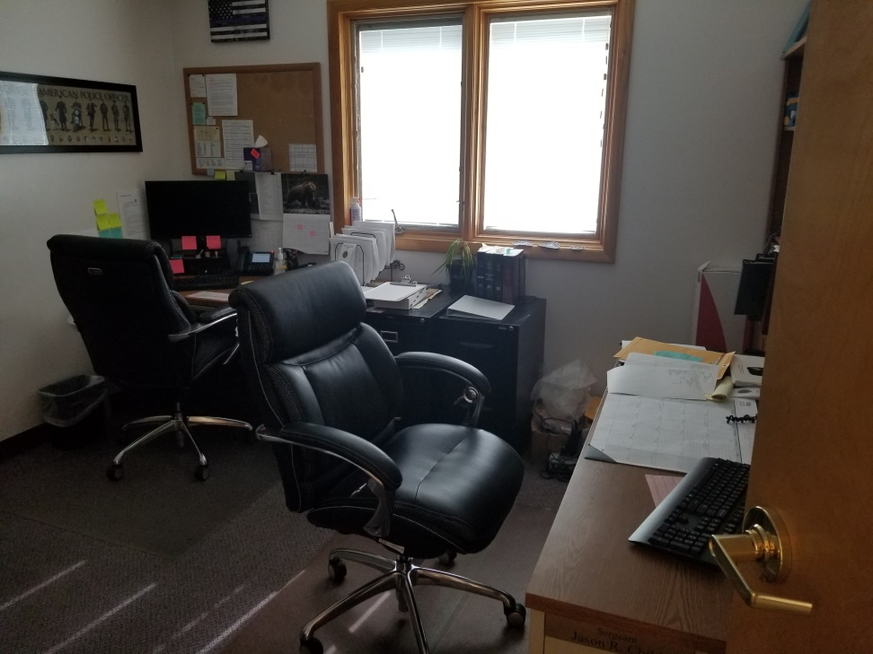
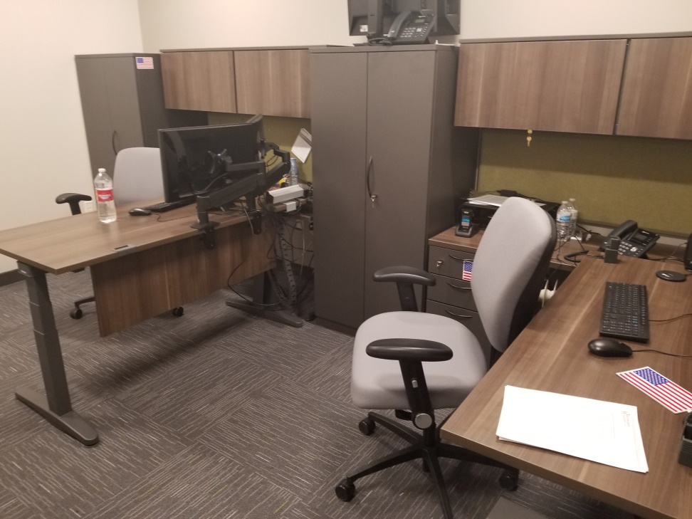
SUPERVISOR OFFICES
NORTH OGDEN PD
TOOELE PD

Slide 20
EVIDENCE PROCESSING
SPACE FOR OFFICERS TO PROCESS AND PACKAGE EVIDENCE IS ONE OF THE LARGEST DEFICIENCIES OF OUR CURRENT FACILITY. AS YOU WILL SEE IN THE NEXT SLIDE OUR CURRENT AREA FOR PROCESSING AND PACKAGING EVIDENCE IS LACKING SPACE, STORAGE, AND THE EQUIPMENT NEEDED FOR EFFFICIENT AND EFFECTIVE PROCESSING OF EVIDENCE.

Slide 21
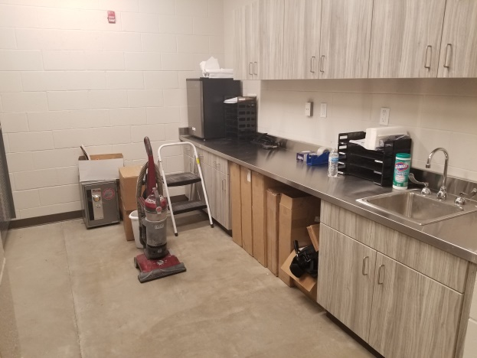
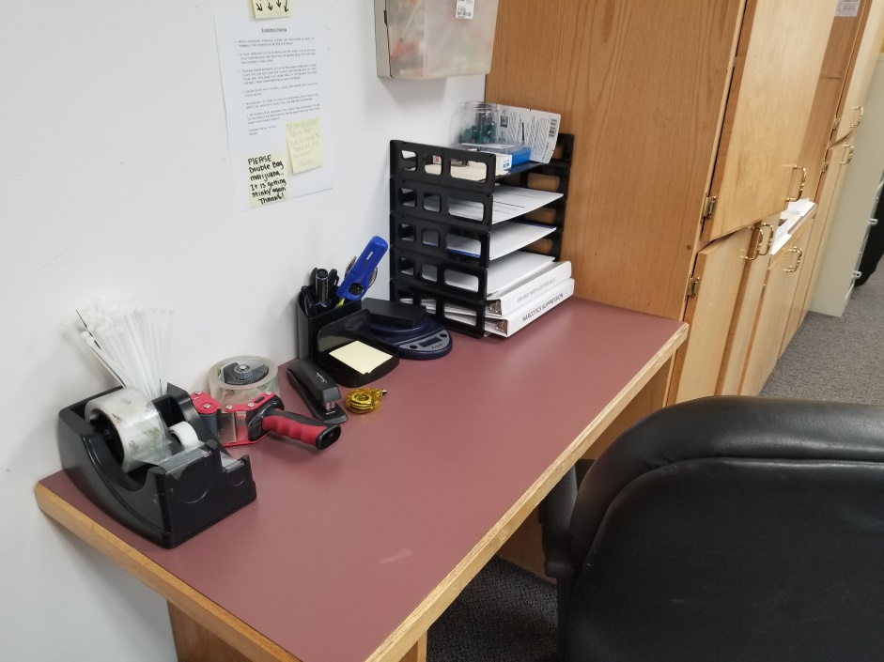
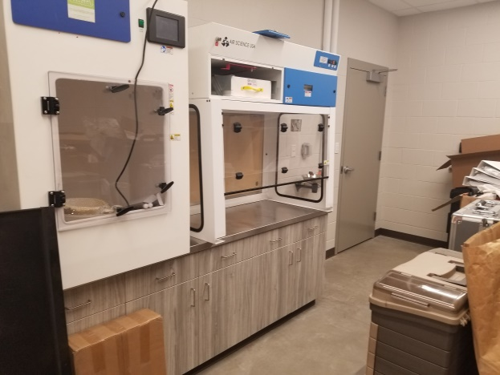
EVIDENCE PROCESSING
NORTH OGDEN PD
TOOELE PD

Slide 22
EVIDENCE STORAGE
FOLLOWING SUIT WITH EVIDENCE PROCESSING IS EVIDENCE STORAGE. THE INTEGRITY OF OUR EVIDENCE IS CRUCIAL FOR SUCCESSFUL PROSECUTION OF CASES AND JUSTICE FOR OUR VICTIMS. CURRENT BEST PRACTICES CALL FOR A SEPARATION OF GUNS, MONEY, AND DRUGS FROM OTHER ITEMS OF EVIDENCE. WE DO NOT CURRENTLY HAVE THE SPACE OR THE RESOURCES TO ACCOMPLISH THIS.

Slide 23
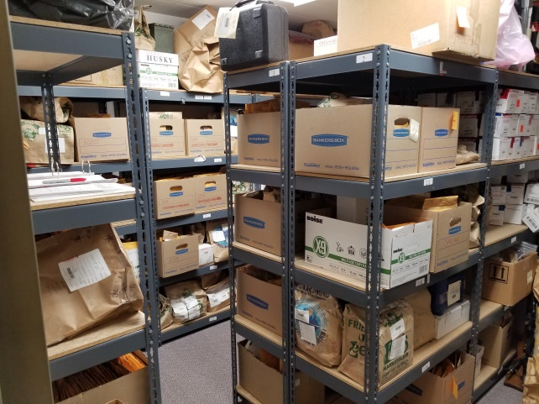
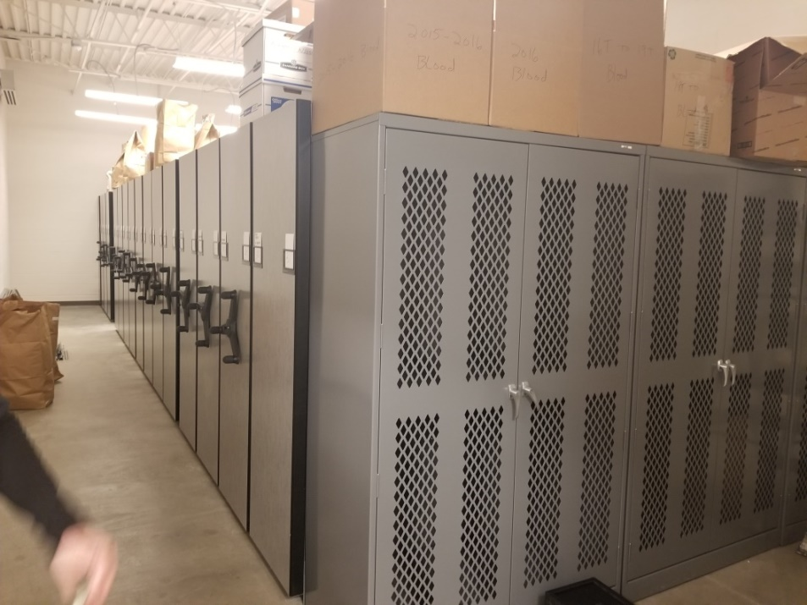
EVIDENCE STORAGE
NORTH OGDEN PD
TOOELE PD

Slide 24
DETAINEE PROCESSING
PROCESSING A DETAINEE IS ONE OF THE MOST DANGEROUS THINGS DONE IN A POLICE DEPARTMENT. FOR THE SAFETY OF STAFF AND DETAINEES, THE AREA DESIGNATED FOR PROCESSING DETAINEES NEEDS SPECIFIC SECURITY MEASURES IN PLACE. OUR CURRENT FACILITY IS NOT SAFE. THERE IS NO SECURE AREA TO PLACE A DETAINEE WHILE IN THE BUILDING. THERE IS NO SEPERATION BETWEEN DETAINEES AND CIVILIAN STAFF. HAVING A UNSECURED DETAINEE IN THE BUILDING IS A DISTRACTION AND A CONCERN FOR THE ENTIRE STAFF.

Slide 25
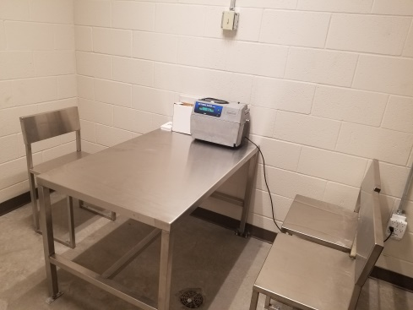
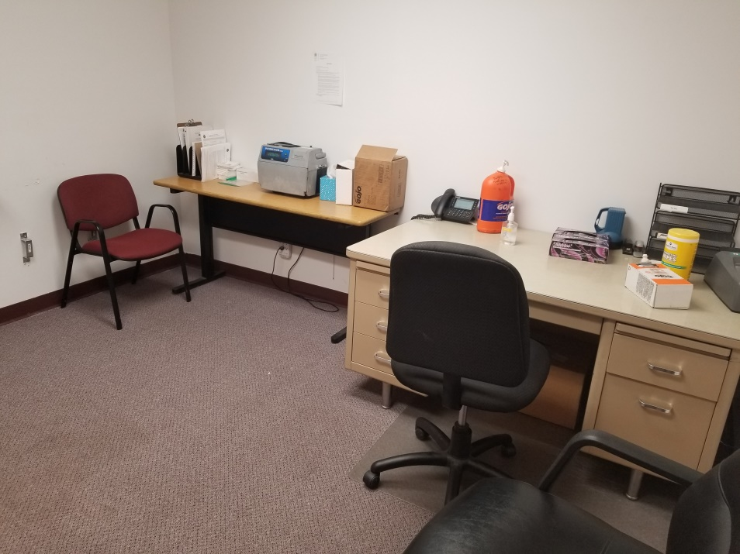
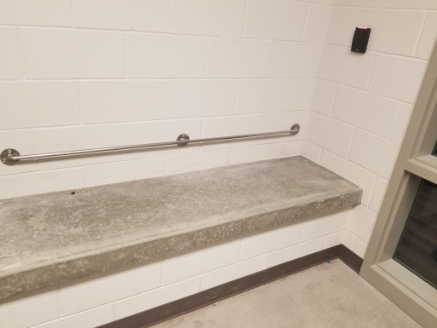
DETAINEE PROCESSING
NORTH OGDEN PD
UNSECURE
TOOELE PD
SECURE

Slide 26
HARD AND SOFT INTERVIEW ROOMS
INTERVIEW ROOMS SERVE SPECIFIC PURPOSES DEPENDING ON WHO IT IS THAT IS BEING INTERVIEWED. VICTIMS AND WITNESSES FEEL MORE COMFORTABLE TALKING IN A ROOM THAT IS WARM AND WELCOMING. THESE ARE REFERRED TO AS SOFT INTERVIEW ROOMS. DETAINEES ARE A RISK TO THEMSELVES AND STAFF. DETAINEES MUST BE INTERVIEWED IN A ROOM THAT DOES NOT CONTAIN POTENTIAL WEAPONS OR ITEMS FOR SELF HARM. THESE INTERVIEW ROOMS MUST ALSO HAVE THE ABILITY TO BE SECURED FROM THE OUTSIDE. THESE ARE REFERRED TO AS HARD INTERVIEW ROOMS.

Slide 27
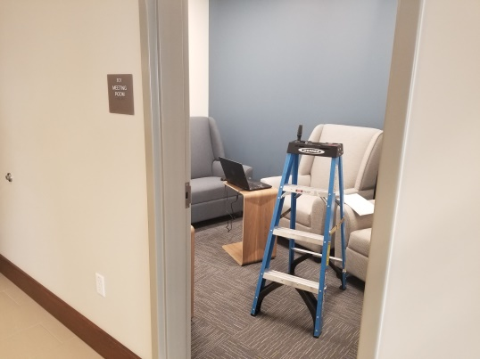
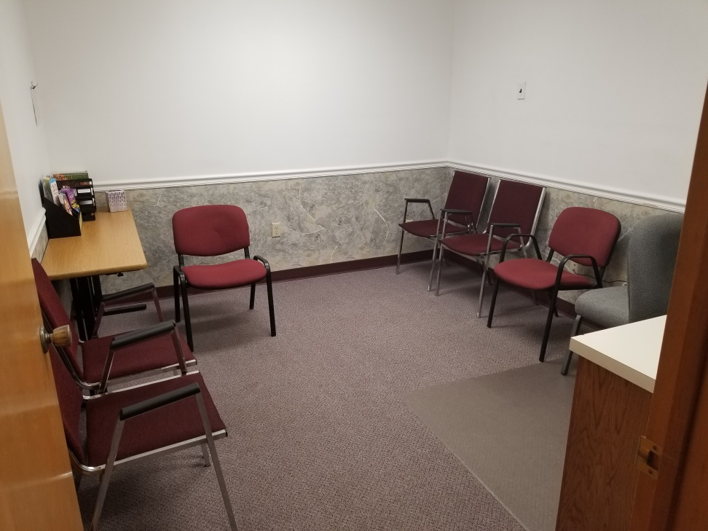
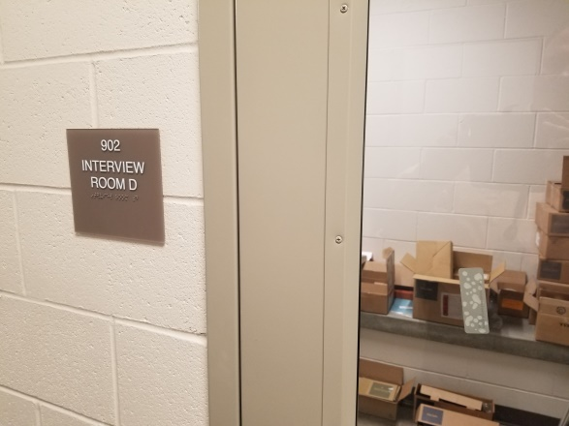
HARD AND SOFT INTERVIEW ROOMS
SOFT
HARD
NORTH OGDEN PD
SINGLE INTERVIEW ROOM
TOOELE PD

Slide 28
PRISONER TRANSFER ZONE
ONE OF THE MOST COMMON TIMES FOR A PRISONER TO ATTEMPT TO ESCAPE IS WHEN TRANSFERING THE PRISONER BETWEEN A VEHICLE AND THE STATION. OUR CURRENT OPTION FOR UNLOADING PRISONERS FROM TRANSPORT VEHICLES IS IN AN UNSECURE PARKING LOT THAT IS SHARED BY CITIZENS AND CIVILIAN STAFF. MODERN FACILITIES HAVE WHAT IS TERMED A SALLY PORT FOR SECURE PRISONER LOADING AND UNLOADING.

Slide 29
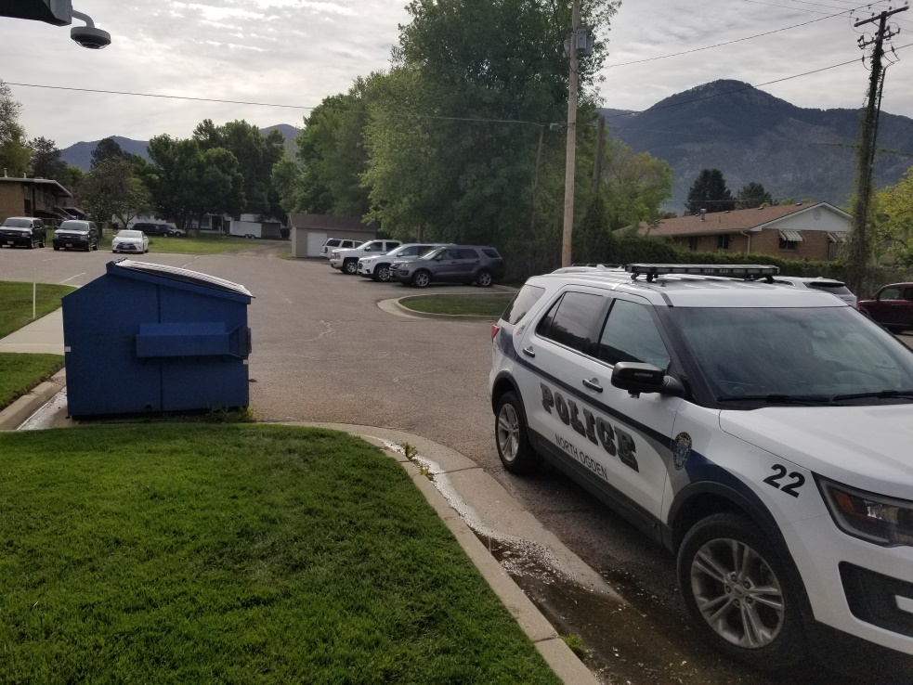
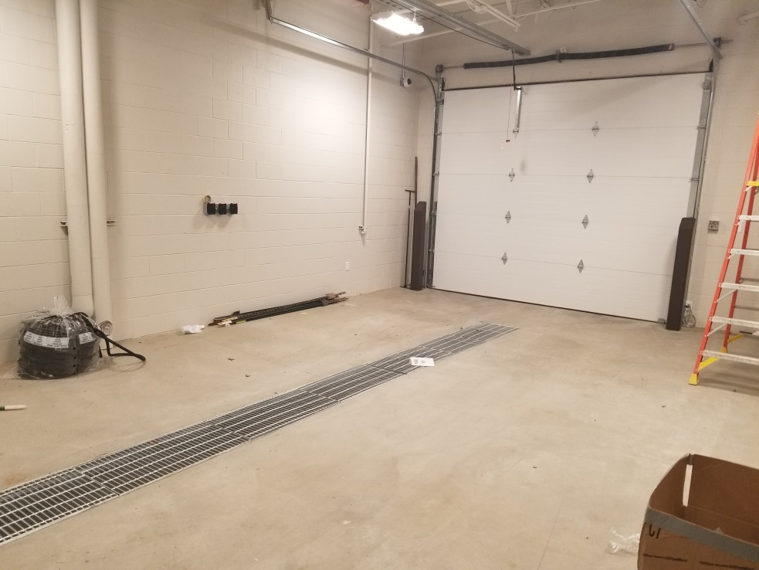
PRISONER TRANSFER ZONE
NORTH OGDEN PD
UNSECURE
TOOELE PD
SECURE

Slide 30
STAFF PARKING
OUR CURRENT FACILITY IS LACKING A SECURE PARKING AREA. WHEN A POLICE VEHICLE IS PARKED IN OUR PARKING LOT THERE IS NOTHING PREVENTING SOMEONE WITH A GRUDGE FROM TAMPERING WITH OUR VEHICLES. IT IS ALSO AN EERIE FEELING ANYTIME AN OFFICER WALKS OUT OF THE OFFICE AT 2:00 AM INTO A DARK AND UNSECURE PARKING LOT. A FEW COVERED PARKING STALLS ARE IMPORTANT FOR THE PATROL STAFF. THIS CAN PREVENT SNOW ACCUMULATION IN THE WINTER AND HEAT IN THE SUMMER FROM DAMAGING EXPENSIVE EQUIPMENT.

Slide 31
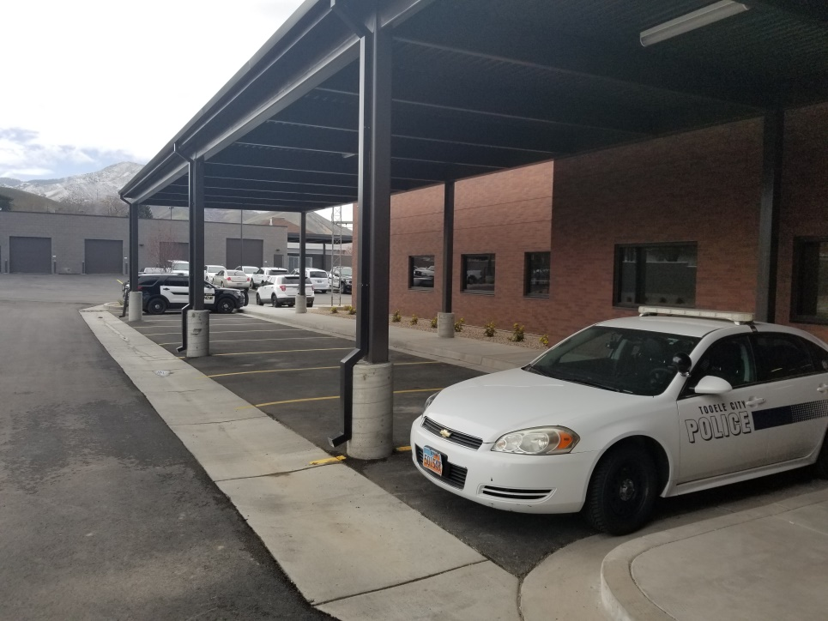
STAFF PARKING
NORTH OGDEN PD
UNSECURE
TOOELE PD
SECURE

Slide 32
ANCILLARY BUILDING-VEHICLE/HAZARDOUS/BULK STORAGE
VEHICLE, BULK, AND HAZARDOUS MATERIAL STORAGE IS BECOMING MORE AND MORE CRUCIAL AS WE GROW. QUITE OFTEN WE SEIZE VEHICLES FOR EVIDENCE. HAVING A SECURE BAY WHERE A VEHICLE CAN BE PROCESSED IS IMPORTANT FOR THE INTEGRITY OF THAT EVIDENCE. STORAGE OF BULK AND HAZARDOUS ITEMS SHOULD NOT BE DONE IN THE MAIN FACILITY.

Slide 33
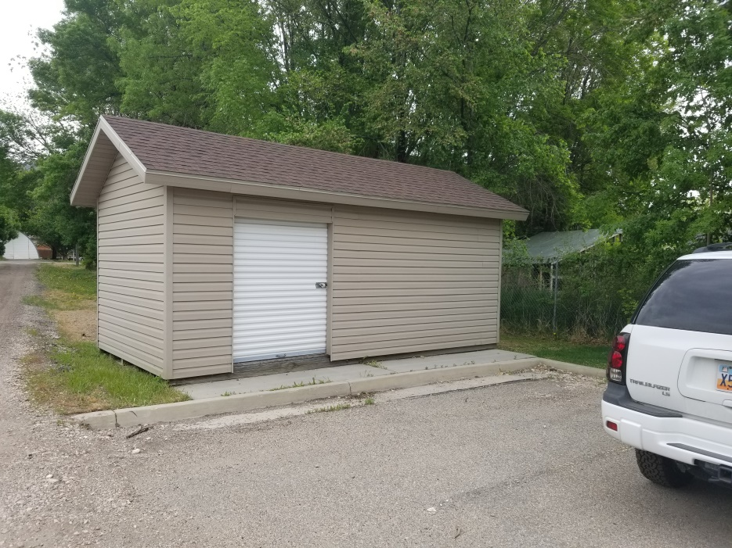
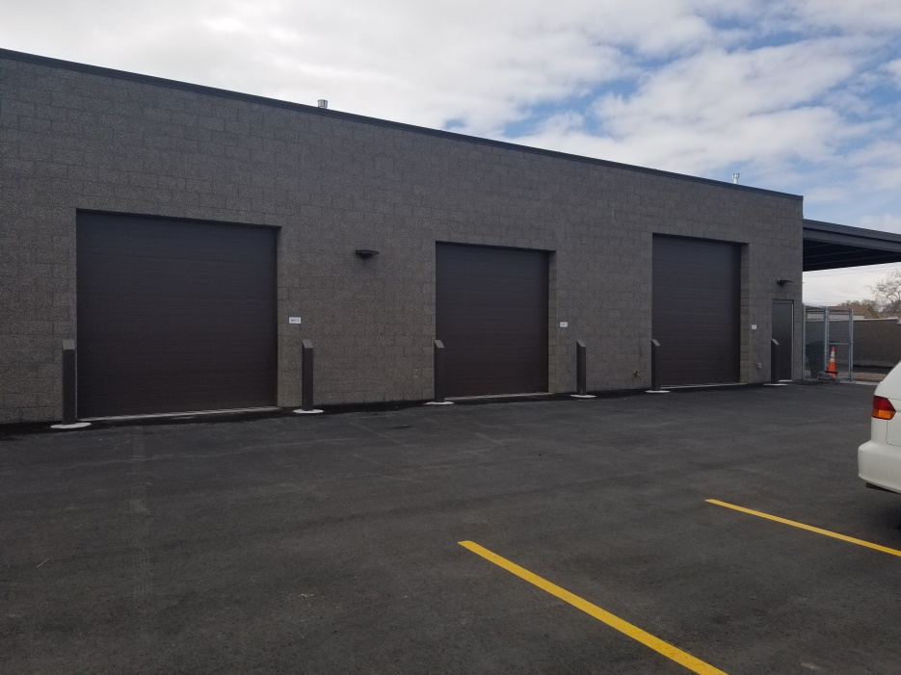
ANCILLARY BUILDING-BULK STORAGE
NORTH OGDEN PD
TOOELE PD

Slide 34
COURT/TRAINING/MEETING ROOM
OUR COURT ROOM DOES NOT MEET STATE CERTIFICATION STANDARDS. MOST OF THE DEFICIENCIES ARE RELATED TO THE SAFETY OF STAFF AND ATTENDESS. THE SIZE OF OUR CURRENT COURT ROOM AND MEETING SPACES FOR ATTORNIES AND THEIR CLIENTS AND PROBATION OFFICERS AND THEIR CLIENTS IS LACKING IF NOT NONEXISTENT. THIS SPACE IN A NEW FACILITY CAN SERVE MULTIPLE PURPOSES. UTILIZING PARTITIONS IT CAN EASILY BE TRANSFORMED INTO TRAINING AND MEETING ROOMS LARGE ENOUGH TO ACCOMMODATE THE ENTIRE CITY STAFF.

Slide 35
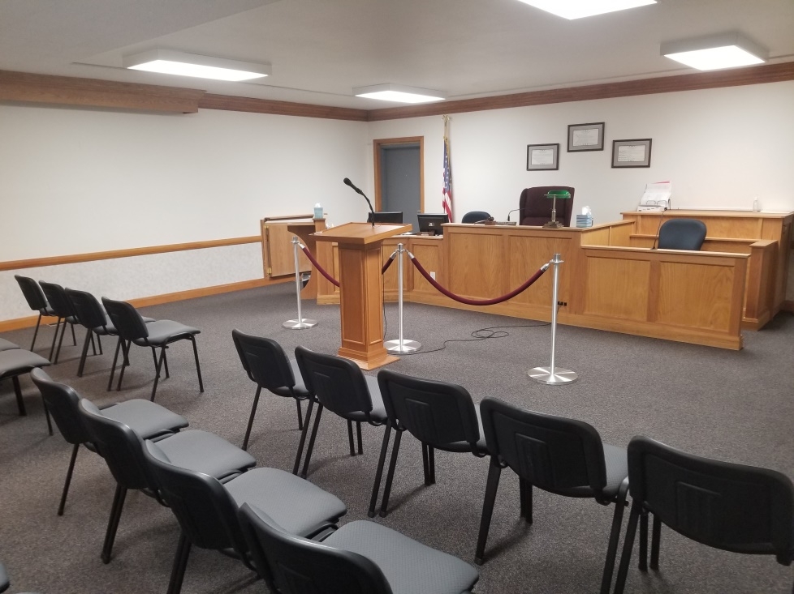
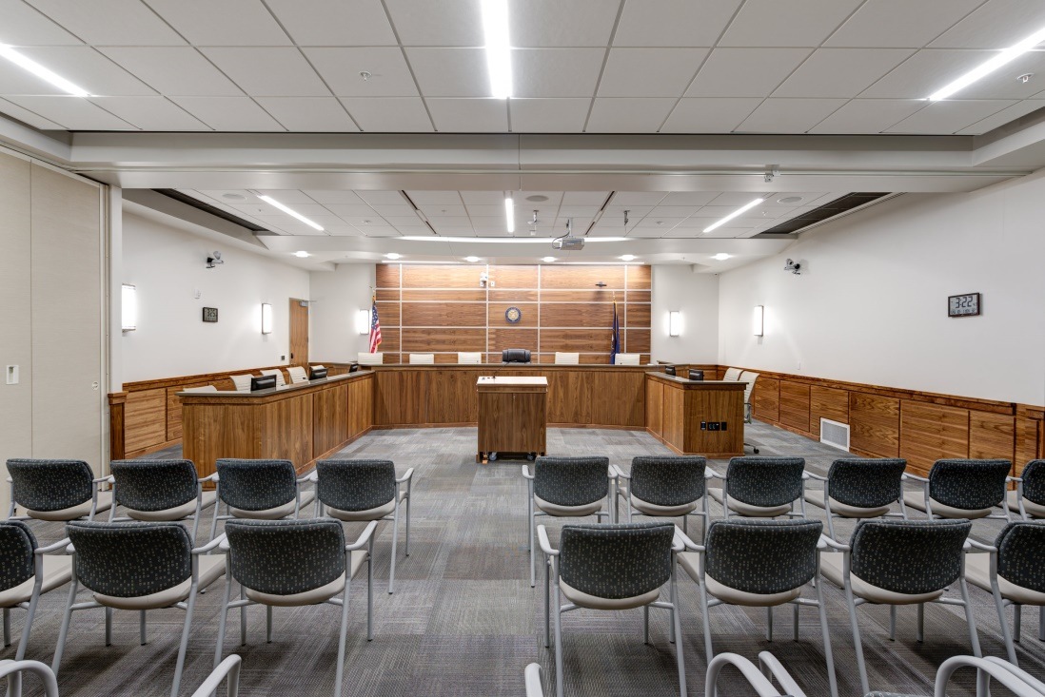
COURT/TRAINING/MEETING ROOM
NORTH OGDEN JUSTICE COURT
THIS IS ACTUALLY BLUFFDALE CITY
TOOELE’S FACILITY DOES NOT HAVE A COURT

Slide 36
THE FOLLOWING SLIDES ARE PHOTOS OF MODERN POLICE FACILITY FEATURES THAT ARE MISSING FROM THE NORTH OGDEN POLICE DEPARTMENT’S CURRENT FACILITY

Slide 37
A SECURE VESTIBULE IS IMPORTANT FOR SOMEONE NEEDING IMMEDIATE POLICE ASSISTANCE AFTER BUSINESS HOURS. MECHANISMS WOULD BE IN PLACE FOR THE PERSON TO LOCK THEMSELVES IN THE VESTIBULE AND IMMEDIATELY BE CONNECTED TO OUR DISPATCH CENTER. SPACE FOR LACTATION AND FOR DECOMPRESSION IS MANDATORY IN A NEW FACILITY. A SAFE AND SECURE AREA WHERE OFFICERS CAN GO AND WORK ON THEIR PHYSICAL FITNESS IS CRUCIAL. THIS AREA CAN ALSO BE UTILIZED BY OTHER CITY EMPLOYEES.

Slide 38
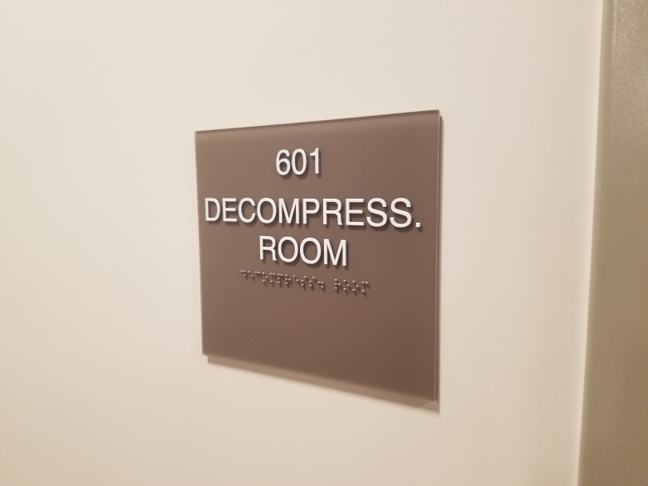
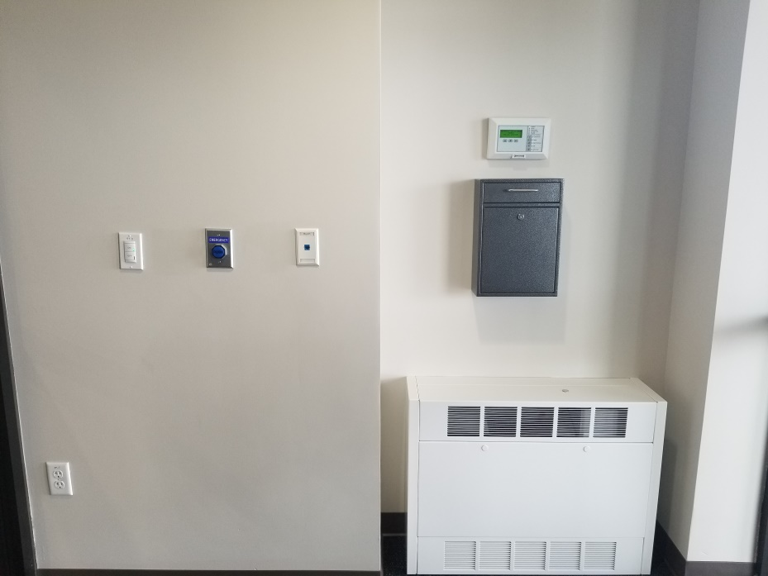
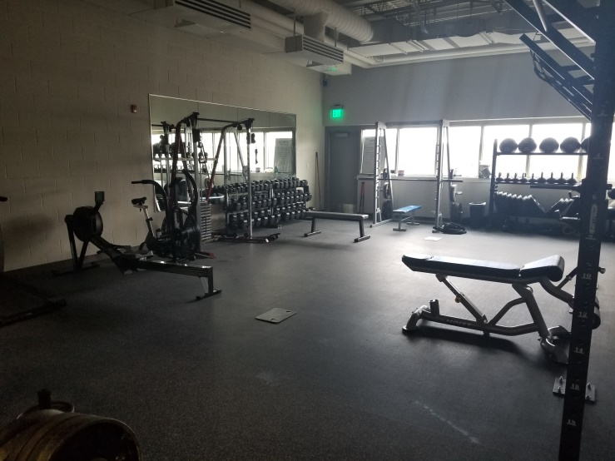
DECOMPRESS/LACTATION ROOM
SECURE AFTER HOURS VESTIBULE
FITNESS AREA

Slide 39
TO SAY OUR CURRENT FACILITY IS LACKING STORAGE IS AN UNDERSTATEMENT. WE HAVE ONE ROOM IN THE BUILDING WHICH IS DESIGNATED FOR STORAGE. NEARLY EVERY OCCUPANT OF AN OFFICE HAS, OUT OF NECESSITY, NEEDED TO UTILIZE FLOOR SPACE FOR STORAGE.

Slide 40
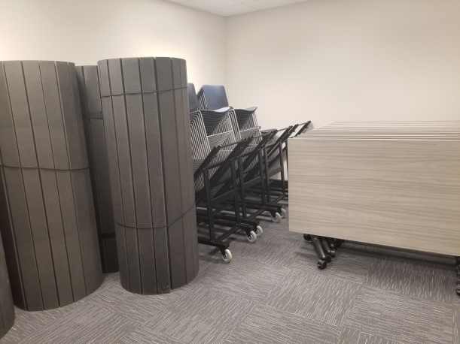
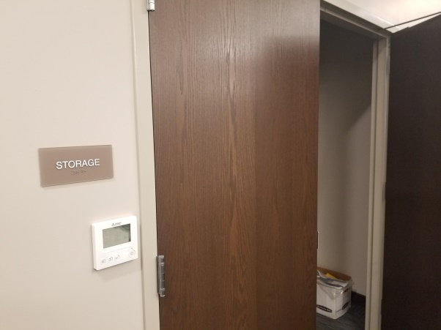
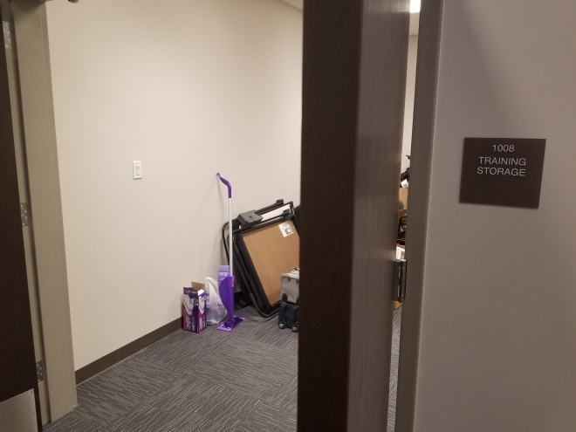
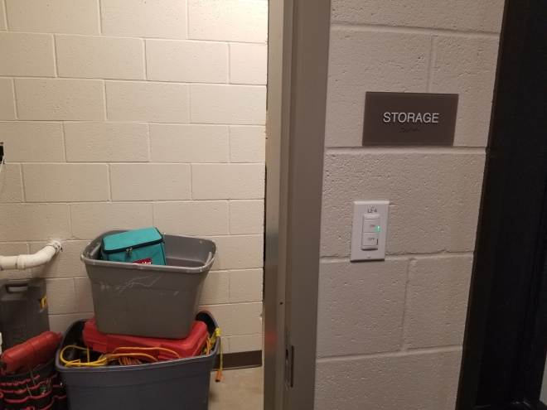
STORAGE, STORAGE, STORAGE

Slide 41
QUARTERMASTER STORAGE IS ESSENTIALLY A PLACE TO STORE UNIFORM AND EQUIPMENT ITEMS ISSUED BY THE DEPARTMENT. A PUBLIC PROPERTY PICKUP LOCATION IS WHERE THE EVIDENCE TECHNICIAN CAN EXCHANGE OR RELEASE ITEMS TO THE PUBLIC SAFELY. CURRENTLY WHEN OUR TECH RELEASES ITEMS SUCH AS KNIVES OR GUNS SHE HAS TO DO IT HAND TO HAND IN OUR FRONT LOBBY. THIS IS OBVIOUSLY A SAFETY CONCERN. A DESIGNATED ICAC (INTERNET CRIMES AGAINST CHILDREN) OFFICE IS NEEDED DUE TO THE SENSITIVE MATERIAL RELATED TO THOSE CRIMES. THAT MATERIAL HAS STRICT GUIDELINES AS TO WHERE IT CAN BE STORED AND WHO CAN POSSESS IT.

Slide 42
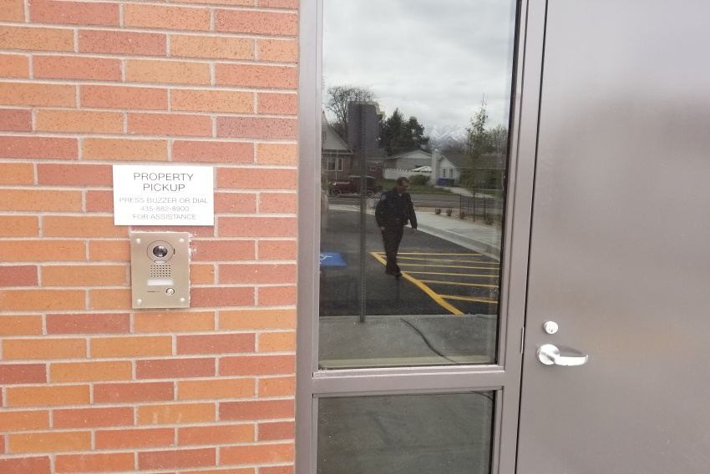
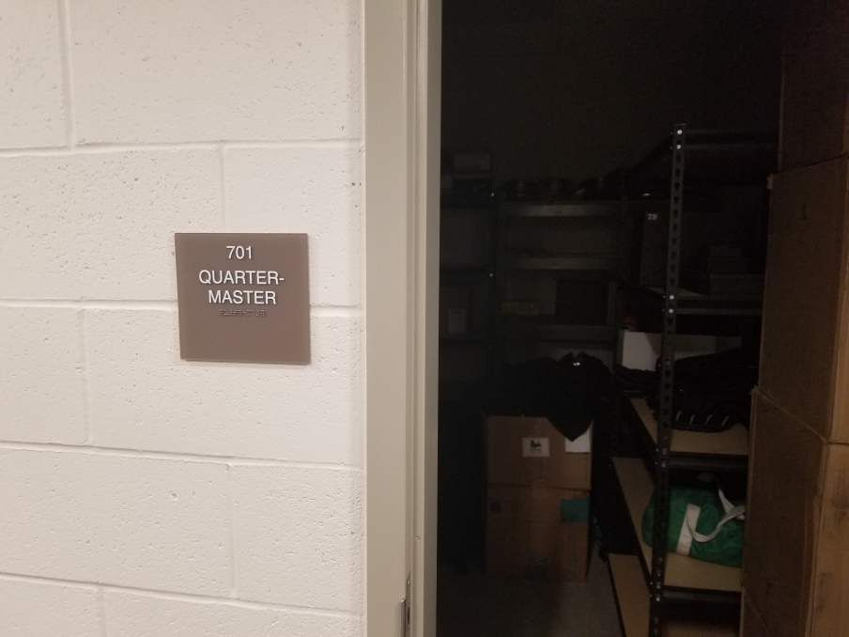
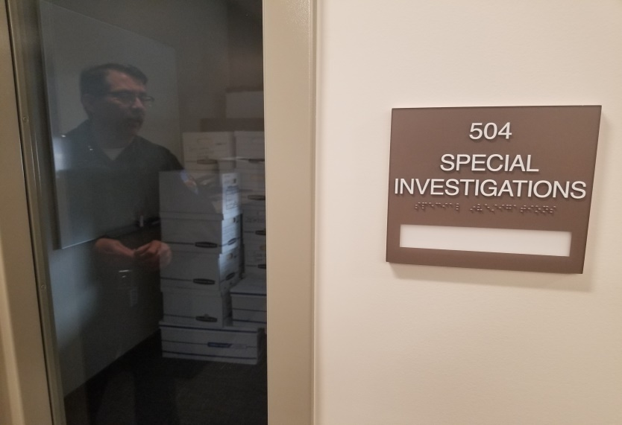
PUBLIC PROPERTY PICKUP
QUARTER MASTER STORAGE
DESIGNATED ICAC OFFICE

Slide 43
WE CURRENTLY HAVE NO DESIGNATED STORAGE FOR DEPARTMENT OWNED FIREARMS AND MUNITIONS. AN ARMORY WOULD BE A SECURE PLACE FOR OUR RANGE MASTER TO STORE THESE ITEMS. THE OFFICERS ARE REQUIRED TO KEEP THEIR FIREARMS MAINTAINED AND CLEAN AT ALL TIMES. WITHOUT A SPACE DESIGNATED FOR THAT IT IS OFTEN DONE ON THE NEAREST DESK. OFFICERS AND DETAINEES ARE OFTEN EXPOSED TO FLUIDS AND MATERIALS THAT ARE BOTH DANGEROUS AND/OR UNPLEASANT. A PLACE TO DECONTAMINATE OR WASH PERSONS AND UNIFORMS IS ESSENTIAL.

Slide 44
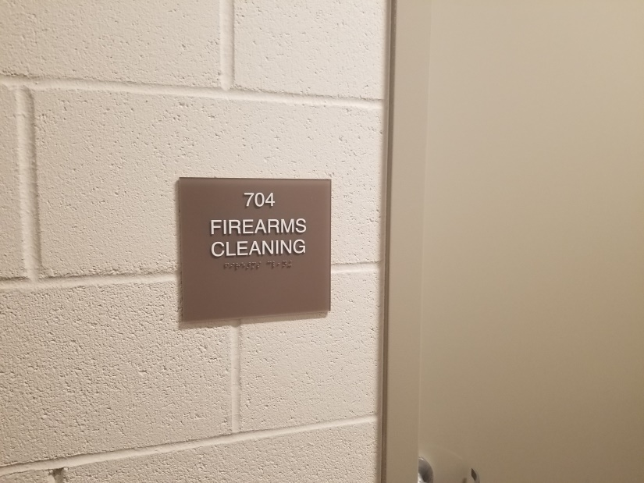
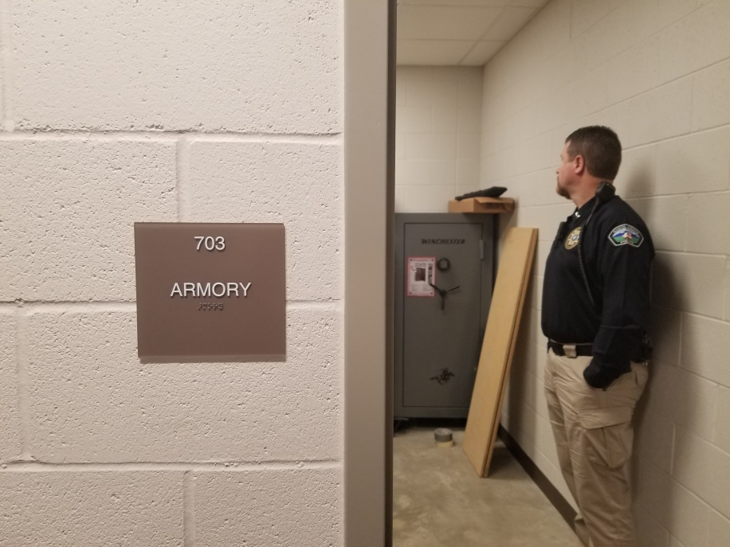
FIREARMS MAINTENANCE
ARMORY
DECONTAMINATION AREA

Slide 45
AS NOTED PREVIOUSLY, COVERED PARKING AND A PLACE FOR VEHICLE AND BULK STORAGE ARE WAYS TO HELP STAFF EFFICIENTLY AND EFFECTIVELY COMPLETE THEIR TASKS. IN THE CASE AN OFFICER HAS BEEN DISPATCHED TO AN EMERGENCY CALL, THE TIME IT TAKES TO CLEAN SNOW FROM A CAR COULD MEAN THE DIFFFERENCE BETWEEN LIFE AND DEATH. THE ONSITE ANCILLARY BUILDING POSITIONED WITHIN THE SECURE PARKING AREA IS JUST ANOTHER WAY TO ENSURE THE SECURITY OF PUBLIC PROPERTY.

Slide 46
VEHICLE EXAM BAY
PATROL COVERED PARKING
SNOW/HEAT
BULK STORAGE

Slide 47
THANK YOU FOR JOINING US ON THE VIRTUAL TOUR OF THE NORTH OGDEN POLICE DEPARTMENT AS IT COMPARES TO A MODERN, UP-TO-DATE, FACILITY. IF YOU HAVE ANY QUESTIONS OR WOULD LIKE MORE INFORMATION PLEASE REACH OUT TO THE NORTH OGDEN POLICE DEPARTMENT. PHONE 801-782-7219
SPECIAL THANKS TO CHIEF KIRBY AND HIS STAFF AT THE TOOELE POLICE DEPARTMENT.

